Slide 1
Naïve Bayes Algorithms
Instructor: Aidos Sarsembayev, Alexey Leshev

Slide 2
Outline:
What are Naïve Bayes Algorithms?
How NB works?
Advantages and disadvantages of using NB
Gaussian, Multinomial, and Bernoulli NB models.

Slide 3
What are Naïve Bayes Algorithms?
Naïve Bayes algorithms are among the most famous supervised learning algorithms.
They are used in classification.
NB is inherently multiclass – i.e. you can easily apply it to cases where you have more than one type of output.
There are extremely easy to build and very useful for very large data sets.

Slide 4
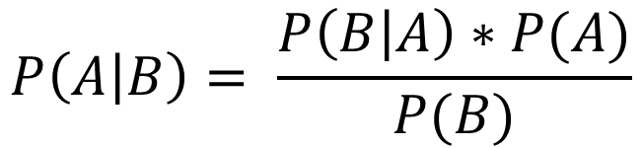
Bayes Theorem
3. Likelihood
1. Prior Probability
4. Posterior probability
$$P\left(A | B\right)= \frac{P\left(B | A\right)∗P(A)}{P(B)}$$
2. Marginal Likelihood

Slide 5
Why naïve?
Because Bayes theorem requires some independent assumptions
Bayes theorem is the base for Naïve Bayes machine learning algorithm
Hence Naïve Bayes also relies on these assumptions which are often not correct, and therefore – NAÏVE.

Slide 6
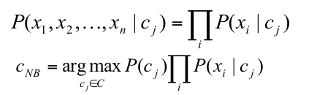
Naïve Bayes
Naïve Bayes Assumption:
Features are independent given class (This is a strong assumption):
P(X₁,X₂|c_{j}) = P(X₁|X₂, c_{j})P(X₂|c_{j}) = P(X₁|c_{j})*P(X₂|c_{j})

Slide 7
‘Walking Dead’ example =)

Slide 8
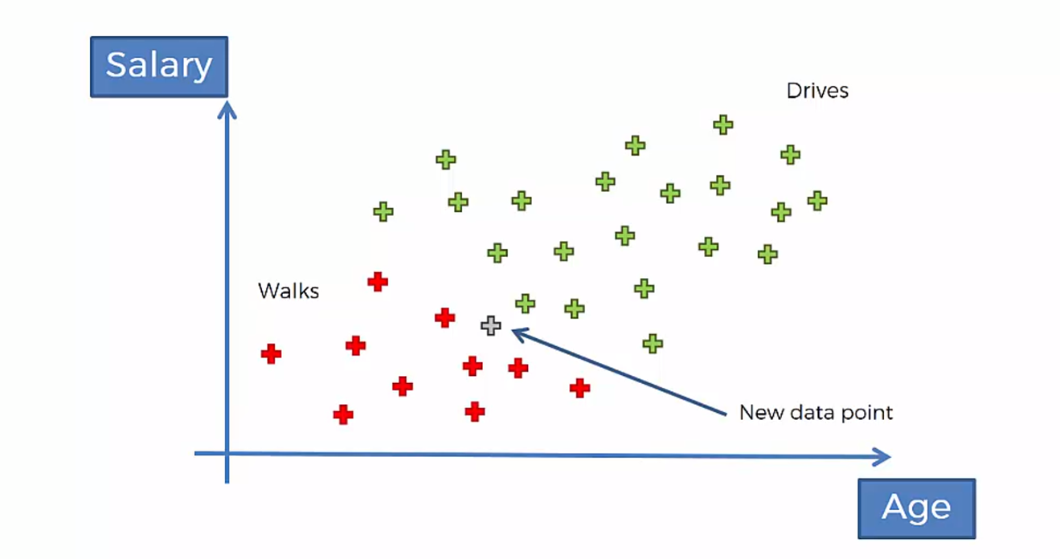

Slide 9
According to Naïve Bayes algorithm the ‘Age’ and ‘Salary’ parameters should be independent from each other
However this is not always case. Also here…

Slide 10
Bayes Theorem applied to the current example
3. Likelihood
1. Prior Probability
4. Posterior probability
$$P\left(A | B\right)= \frac{P\left(B | A\right)∗P(A)}{P(B)}$$
2. Marginal Likelihood

Slide 11
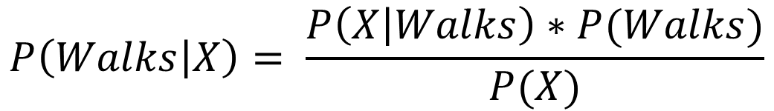
Bayes Theorem applied to the current example (1/3)
X – are the features of a some particular datapoint
3. Likelihood
1. Prior Probability
4. Posterior probability
$$P\left(Walks | X\right)= \frac{P\left(X | Walks\right)∗P(Walks)}{P(X)}$$
2. Marginal Likelihood

Slide 12
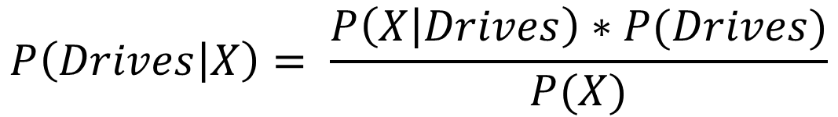
Bayes Theorem applied to the current example (2/3)
X – are the features of a some particular datapoint
3. Likelihood
1. Prior Probability
4. Posterior probability
$$P\left(Drives | X\right)= \frac{P\left(X | Drives\right)∗P(Drives)}{P(X)}$$
2. Marginal Likelihood

Slide 13
Bayes Theorem applied to the current example (3/3)
$$P\left(Walks | X\right)=P\left(Drives | X\right)$$

Slide 14

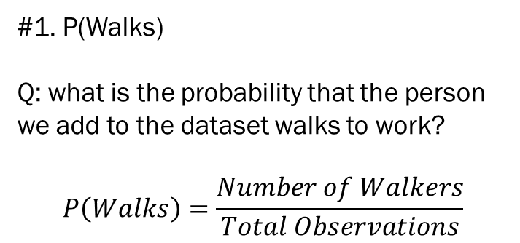
Step #1
#1. P(Walks)
Q: what is the probability that the person we add to the dataset walks to work?
$$P\left(Walks\right)=\frac{Number of Walkers}{Total Observations}$$
$$P\left(Walks\right)=\frac{10}{30}$$

Slide 15
Bayes Theorem applied to the current example (2/3)
X – are the features of a some particular datapoint
3. Likelihood
1. Prior Probability
4. Posterior probability
$$P\left(Drives | X\right)= \frac{P\left(X | Drives\right)∗P(Drives)}{P(X)}$$
2. Marginal Likelihood

Slide 16
Step #2
#2. P(X)
Q: what is the probability of a new point we add to the dataset being similar in features to the point that we are actually adding to the dataset?
OR simply – what is P for a new point to fall into this circle?

Slide 17
Step #2
#2. P(X)
Let’s get rid of the new observation for a moment and assume that all of the four observation have similar features

Slide 18
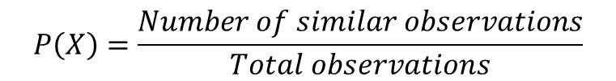

Step #2
#2. P(X)
Let’s get rid of the new observation for a moment and assume that all of the four observation have similar features
$$P\left(X\right)=\frac{Number of similar observations}{Total observations}$$
$$P\left(X\right)=\frac{4}{30}$$

Slide 19
Step #3
#2. P(X|Walks)
Q: What is the likelihood that somebody who walks exhibits features X?

Slide 20
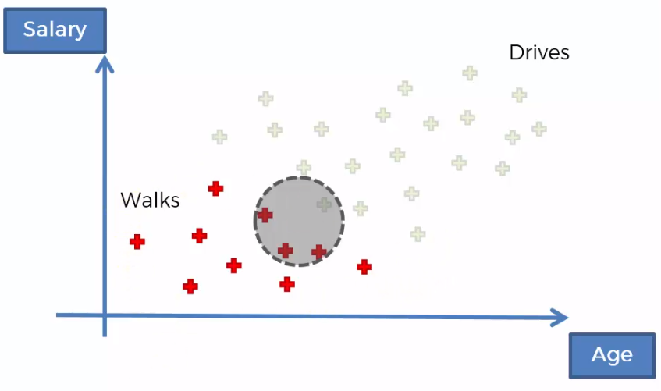
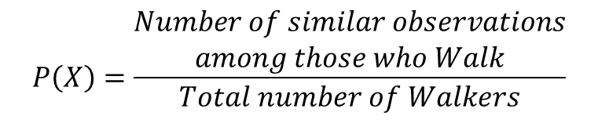

Step #3
#2. P(X|Walks)
Q: What is the likelihood that somebody who walks exhibits features X?
$$P\left(X\right)=\frac{\begin{aligned}Number of similar observations \\ among those who Walk\end{aligned}}{Total number of Walkers}$$
$$P\left(X\right)=\frac{3}{10}$$

Slide 21

Plug all in
$$P\left(Walks|X\right)=\frac{\frac{3}{10} ∗\frac{10}{30}}{\frac{4}{30}}=0,75$$

Slide 22
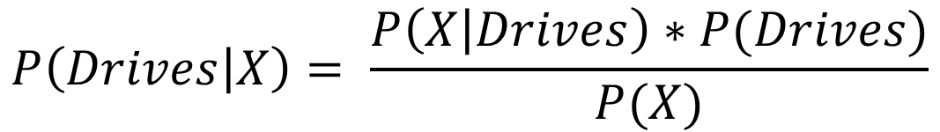
Try it yourself …
$$P\left(Drives | X\right)= \frac{P\left(X | Drives\right)∗P(Drives)}{P(X)}$$

Slide 23

Plug all in
$$P\left(Drives|X\right)=\frac{\frac{1}{20} ∗\frac{20}{30}}{\frac{4}{30}}=0,25$$

Slide 24
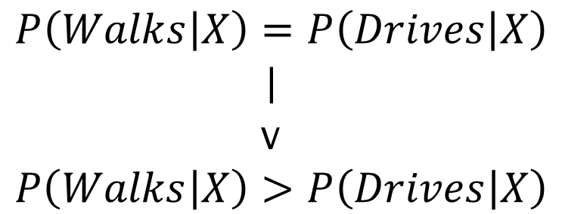
Compare
$$P\left(Walks | X\right)=P\left(Drives | X\right)$$
|
v
$$P\left(Walks | X\right)>P\left(Drives | X\right)$$

Slide 25


Another example
M1
M2

Slide 26
Spanners example
What’s the P that M2 produces defective spanner?
M2

Slide 27
What is given?
M1: 30 spanners/hr
M2: 20 spanners/hr
Out of all produced parts:
We can SEE that 1% are defective
Out of all defective parts:
We can SEE that 50% came from M1
And 50% from M2
Q: what is the probability that a part produced by M2 is defective?

Slide 28
What is given?
M1: 30 spanners/hr
M2: 20 spanners/hr
Out of all produced parts:
We can SEE that 1% are defective
Out of all defective parts:
We can SEE that 50% came from M1
And 50% from M2
Q: what is the probability that a part produced by M2 is defective?
P(M1) = 30/50 = 0,6
P(M2) = 20/50 = 0,4

Slide 29
What is given?
M1: 30 spanners/hr
M2: 20 spanners/hr
Out of all produced parts:
We can SEE that 1% are defective
Out of all defective parts:
We can SEE that 50% came from M1
And 50% from M2
Q: what is the probability that a part produced by M2 is defective?
P(M1) = 30/50 = 0,6
P(M2) = 20/50 = 0,4
P(Defect) = 1% OR 0,01

Slide 30
What is given?
M1: 30 spanners/hr
M2: 20 spanners/hr
Out of all produced parts:
We can SEE that 1% are defective
Out of all defective parts:
We can SEE that 50% came from M1
And 50% from M2
Q: what is the probability that a part produced by M2 is defective?
P(M1) = 30/50 = 0,6
P(M2) = 20/50 = 0,4
P(Defect) = 1% OR 0,01
P(M1|Defect) = 50%
P(M2|Defect) = 50%
P(Defect|M2) - ???

Slide 31
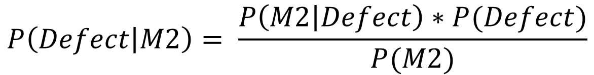
We consider only M2
M2: 20 spanners/hr
We can SEE that 1% are defective
And 50% from M2
Q: what is the probability that a part produced by M2 is defective?
P(M2) = 20/50 = 0,4
P(Defect) = 1% OR 0,01
P(M2|Defect) = 50%
P(Defect|M2) - ???
$$P\left(Defect | M2\right)= \frac{P\left(M2 | Defect\right)∗P(Defect)}{P(M2)}$$

Slide 32
Plug in
M2: 20 spanners/hr
We can SEE that 1% are defective
And 50% from M2
Q: what is the probability that a part produced by M2 is defective?
P(M2) = 20/50 = 0,4
P(Defect) = 1% OR 0,01
P(M2|Defect) = 50%
P(Defect|M2) - ???
$P\left(Defect | M2\right)= \frac{0,5∗0,01}{0,4}$ $=0,0125=1.25\%$

Slide 33
The solution
$P\left(Defect | M2\right)= \frac{0,5∗0,01}{0,4}$ $=0,0125=1.25\%$
For example:
1000 spanners
400 from M2
1% have a defect = 10
50% of them from M2 = 5
Number of parts with defects from M2 -> 5/400 = 1,25%

Slide 34
Example. ‘Play Tennis’ data
Question: For the day <sunny, cool, high, strong>, what’s the play prediction?

Slide 35
Example. ‘Play Tennis’ solution

Slide 36

Underflow Prevention
Multiplying lots of probabilities, which are between 0 and 1 by definition, can result in floating-point underflow.
Since log(xy) = log(x) + log(y), it is better to perform all computations by summing logs of probabilities rather than multiplying probabilities.
Class with highest final un-normalized log probability score is still the most probable.

Slide 37
A few issues with Bayes Algorithm
If categorical variable has a category (in test data set), which was not observed in training data set, then model will assign a 0 (zero) probability to it and will be unable to make a prediction. This is often known as “Zero Frequency”. To solve this, we can use the smoothing technique. One of the simplest smoothing techniques is called Laplace estimation.
This is parameter “alpha” in BernoulliNB and MultinomialNB in python. Default is “alpha = 1”
Naive Bayes a bad estimator – don’t take probability estimations seriously!

Slide 38
Different Types of NB models in Python
What does dictate the type of NB model you can use? The answer is your feature types. Depending on features, you can use 3 different NB models: Gaussian, Bernoulli, and Multinomial
If feature space is quantitative then you shall use GaussianNB
If feature space is Binary, then you better use BernoulliNB
If feature space is discrete counts, then you can use MultinomialNB.
Can you come up with few examples for each class of NB?

Slide 39

Gaussian NB
Your assumption for Gaussian NB is, your feature variables are independent and Normally distributed.
You should make sure, your input features either look normal at their raw format, or look normal after transformation. For instance you can use log transform to make most of positively skewed distributions, symmetric.
For Gaussian NB, we first need to estimate the mean and Standard deviation of each feature.
Once you successfully calibrate your model, you can use probability density function of Normal Distribution to calculate likelihood functions.

Slide 40
Advantages of using NB algorithm
Very easy to compute
Great for multi-class cases
One of the fastest algorithms
There is no parameter needed to be tuned. (an exception might be alpha – which by definition is not a tuning parameter).
The algorithms can be used for real time prediction.
Used often in Text Classification/Spam Filtering/Sentiment Analysis.

Slide 41
Issues with NB
It works under the strong assumption that your feature inputs are independent.
If you have highly dependent variables, you must drop one.
GaussianNB works under the assumption that your inputs are normally distributed. If that is not the case, you either cannot use it or need to transform your variables.
You cannot take probability predictions seriously!

Slide 42
Summary
Definition of NB algorithm
Learned how NB algorithm works
Gaussian NB, Multinomial NB and Bernoulli NB
Limitations and advantages of NB

Slide 43
FIN.

